Slide 1
BIG DATA ANALYTICS
Course Code: 19ECS767
MODULE 1

Slide 2
Course Objectives
Optimize business decisions and create competitive advantage with Big Data analytics.
Introducing Java concepts required for developing map reduce programs.
Derive business benefits from unstructured data.
Imparting the architectural concepts of Hadoop and introducing map reduce paradigm.
To introduce programming tools Hbase & HIVE in Hadoop echo system

Slide 3
What is big data ?
Think of the following:
Every second, there are around 8,22 tweets on Twitter.
Every minute, nearly 510 comments are posted, 293,000 statuses are updated, and 136,000 photos are uploaded on Facebook.
Every hour, Walmart, a global discount departmental store chain, handles more than 1
million customer transactions.
Every day, consumers make around 11.5 million payments by using PayPal. We live in a digital world where data is increasing rapidly because of the ever-increasing use of the Internet, sensors, and heavy machines at a very high rate.

Slide 4
Big Data formal Definition….
Big data refers to extremely large and complex sets of data that cannot be processed or analyzed using traditional data processing techniques.
These data sets are often characterized by their volume, velocity, and variety, which are commonly known as the three Vs of big data.
Volume refers to the sheer amount of data generated by various sources such as social media, sensors, devices, and machines.
Velocity refers to the speed at which data is generated, processed, and analyzed.
Variety refers to the different types of data, both structured and unstructured, that can be generated and analyzed.

Slide 5
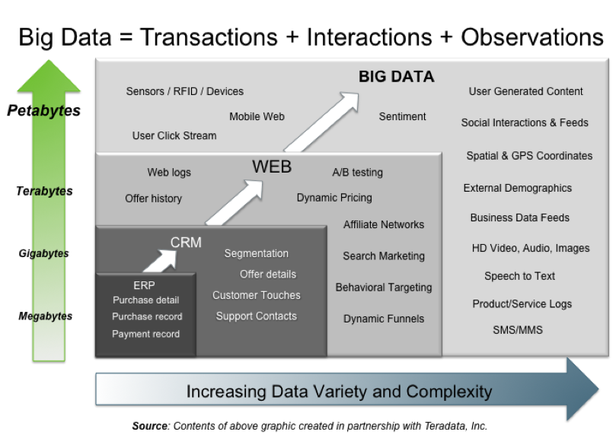
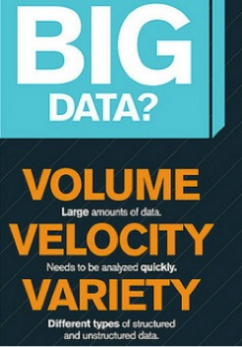
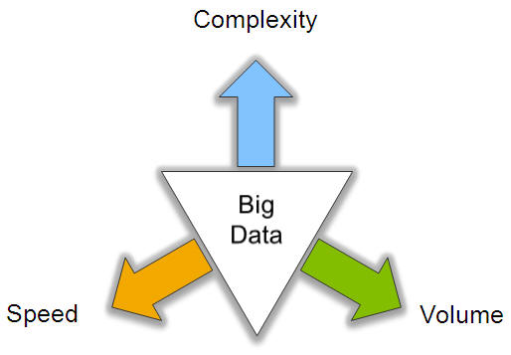
Big Data: 3V’s

Slide 6
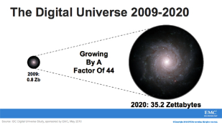
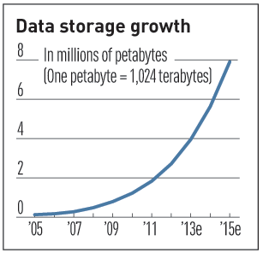

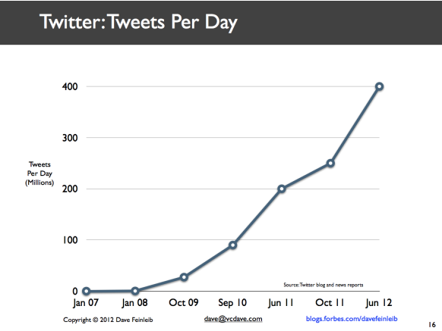
Volume (Scale)
Data Volume
44x increase from 2009 2020
From 0.8 zettabytes to 35zb
Data volume is increasing exponentially
Exponential increase in collected/generated data

Slide 7

Velocity (Speed)
Data is begin generated fast and need to be processed fast
Online Data Analytics
Late decisions ➔ missing opportunities
Examples
E-Promotions: Based on your current location, your purchase history, what you like ➔ send promotions right now for store next to you
Healthcare monitoring: sensors monitoring your activities and body ➔ any abnormal measurements require immediate reaction

Slide 8



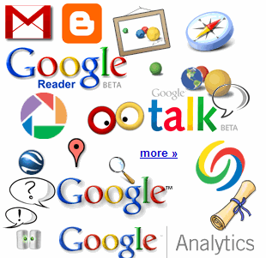

Variety
4.6 billion camera phones world wide
30 billion RFID tags today (1.3B in 2005)
12+ TBs of tweet data every day
100s of millions of GPS enabled devices sold annually
? TBs of data every day
25+ TBs of log data every day
2+ billion people on the Web by end 2011
76 million smart meters in 2009… 200M by 2014

Slide 9
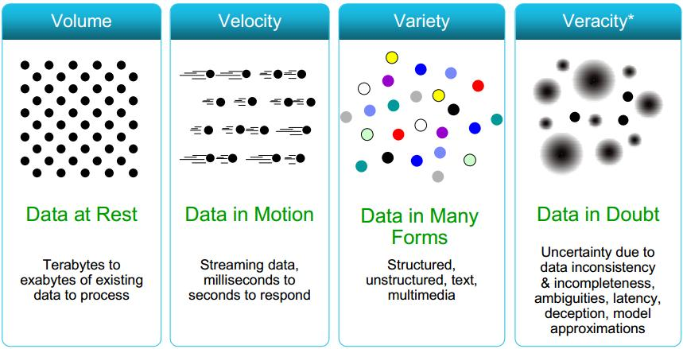
4V’s-another convention

Slide 10
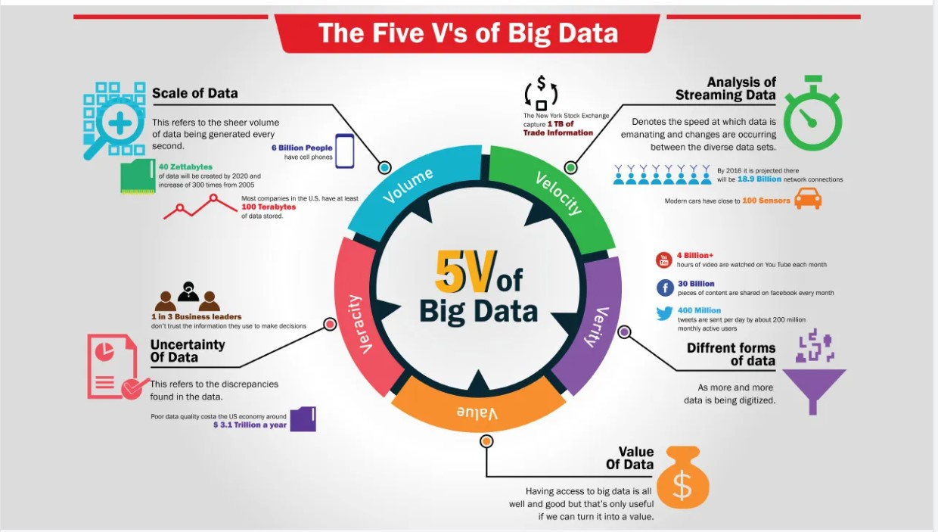

Slide 11
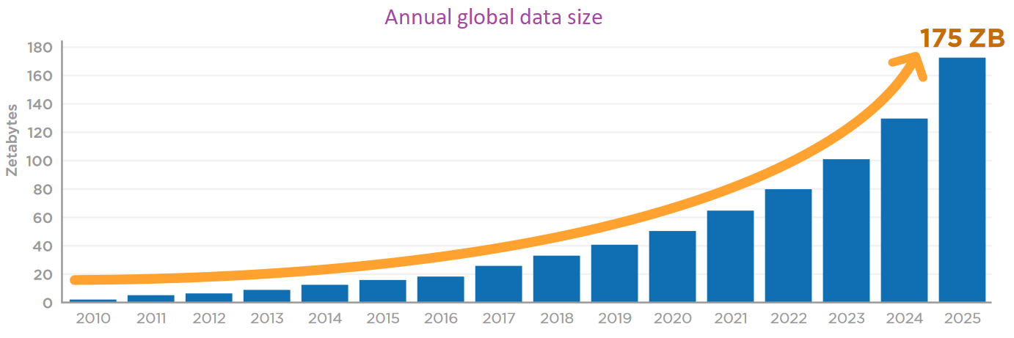
Data Expansion – Day by Day
One of the data production source - Smart electronic devices
Amount of data – 175 ZettaBytes by 2025.
Total volume of data – double every two years.

Slide 12
Various Memory Sizes
NAME | EQUAL TO | SIZE(IN BYTES)
Bit | 1 bit | 1/8
Nibble | 4 bits | 1/2 (rare)
Byte | 8 bits | 1
Kilobyte-KB | 1024 bytes | 1024
Megabyte-MB | 1, 024kilobytes | 1, 048, 576
Gigabyte-GB | 1, 024 megabytes | 1, 073, 741, 824
Terrabyte-TB | 1, 024 gigabytes | 1, 099, 511, 627, 776
Petabyte-PB | 1, 024 terrabytes | 1, 125, 899, 906, 842, 624
Exabyte-EB | 1, 024 petabytes | 1, 152, 921, 504, 606, 846, 976
Zettabyte-ZB | 1, 024 exabytes | 1, 180, 591, 620, 717, 411, 303, 424
Yottabyte-YB | 1, 024 zettabytes | 1, 208, 925, 819, 614, 629, 174, 706, 176

Slide 13

Sources of Big Data
Social media
Sensor placed in various cities
Customer satisfaction feedback
IoT Appliance
E-Commerce
Global Positioning System(GPS)

Slide 14
Sources of Big Data
Social Media
Whatsapp, Facebook, Instagram, Twitter, YouTube etc
Each activity – upload photo/video, making comment, sending a message, like etc create data.
Sensors
Sensors in city – gather temperature, humidity etc
Camera beside roads gather information
Security cameras in airports/banks – create a lot of data
Customer Satisfaction feedback
Amazon, flipkart, firstcry, licious, swiggy, blinkit, zepto etc – gather customer feedback – quality of product/deliver time. It creates a lot of data.

Slide 15
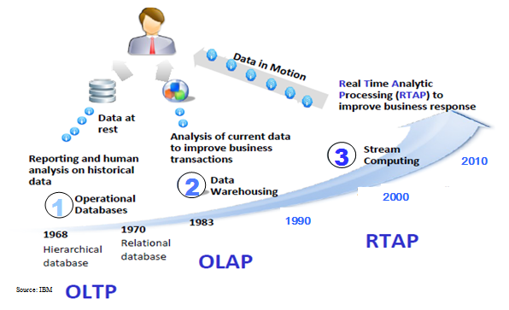
Harnessing Big Data
OLTP: Online Transaction Processing (DBMSs)
OLAP: Online Analytical Processing (Data Warehousing)
RTAP: Real-Time Analytics Processing (Big Data Architecture & technology)

Slide 16
Why Big Data?
There are several reasons why big data has become increasingly important for organizations across different industries:
Improved decision-making: By analyzing big data, organizations can gain valuable insights and make data-driven decisions that can improve business operations and drive growth.
Cost savings: Big data can help organizations identify inefficiencies in their operations and optimize processes, resulting in cost savings.
Improved customer experience: Big data can help organizations better understand their customers and tailor their products and services to meet their needs.
Innovation: Big data can be used to identify new market opportunities and drive innovation in products and services.
Competitive advantage: Organizations that can effectively leverage big data have a significant advantage over their competitors, as they can make faster, more informed decisions based on real-time data.
Risk management: Big data can help organizations identify potential risks and take steps to mitigate them before they become a problem.
Personalization: Big data can help organizations personalize their offerings to customers by analyzing their behavior, preferences, and purchase history.

Slide 17
Convergence of key trends:
The key trends in big data are :
Artificial intelligence (AI) and machine learning: The combination of big data and AI/ML algorithms is enabling organizations to analyze vast amounts of data, identifying patterns, trends, and insights.
Cloud computing: The availability of cloud computing has made it easier and more cost-effective for organizations to store, process, and analyze large amounts of data.
Internet of Things (IoT): The increasing prevalence of connected devices is generating vast amounts of data that can be analyzed to improve processes and drive innovation.
Edge computing: Edge computing is bringing processing power closer to the data source, enabling real-time processing and analysis of data.
Data governance and security: As organizations collect and store more data, the importance of data governance and security is becoming important.
Data visualization and storytelling: As the volume of data being generated and analyzed continues to grow, data visualization and storytelling techniques are becoming important.

Slide 18
Unstructured data
Based on the data received from the different sources, they are classified as:
Structured data
Unstructured data
Semi-structured data
In a real-world scenario, typically, the unstructured data is larger in volume than the structured and semi-structured data, approximately 70% to 80% of data is in unstructured form.
In Big Data Analytics (BDA), unstructured data refers to any data that does not have a predefined data model or schema.
It is typically human-generated and includes things like text documents, images, videos, social media posts, and audio files.
The challenge with unstructured data is that it cannot be easily analyzed using traditional data analysis techniques. However, with the advancements in BDA, it is now possible to analyze unstructured data.

Slide 19
Industry examples of big data
There are numerous examples of industries that are leveraging big data:
Social media analytics: the process of collecting and analyzing audience data shared on social networks to improve an organization's strategic business decisions.
Healthcare: Big data is being used in healthcare to improve patient outcomes, reduce costs, and drive research.
Retail: Retailers are using big data to gain insights into customer behavior, preferences, and purchasing patterns.
Finance: Big data is transforming the finance industry, enabling banks and other financial institutions to improve fraud detection, risk management, and customer engagement.
Manufacturing: Big data is being used in manufacturing to optimize production processes, reduce waste, and improve product quality.
Transportation: The transportation industry is leveraging big data to optimize route planning, reduce fuel consumption, and improve safety.
Energy: Big data is being used in the energy industry to optimize the use of renewable energy sources, reduce costs, and improve energy efficiency. behavior

Slide 20
Web analytics
Web analytics refers to the process of collecting, measuring, and analyzing data about user behavior on a website.
Here are some key components of web analytics:
Data collection: Web analytics tools collect data about user behavior on a website, including metrics like pageviews, bounce rate, time on page, and conversion rate.
Data measurement: Once the data is collected, web analytics tools measure the data against key performance indicators (KPIs) to assess website performance.
Data analysis: Web analytics tools enable users to analyze data to gain insights into user behavior and website performance. For example, an analysis of traffic sources may reveal which marketing channels are driving the most traffic to a website.
Reporting: Web analytics tools provide reporting functionality that enables users to create and share reports that highlight key insights and trends.
There are several web analytics tools available, including Google Analytics, Adobe Analytics, and Piwik. These tools enable organizations to track and analyze website performance and identify user experience.

Slide 21
Big data Layout

Slide 22
Big Data Technologies
Big data technologies refer to the hardware, software, and tools used
to collect, store, manage, analyze, and visualize large volumes of data.
Here are some examples of big data technologies:
Apache Hadoop
Spark
NoSQL databases
MAPREDUCE
HDFS(Hadoop distributed file system)
HIVE
PIG

Slide 23
Introduction to Hadoop
Hadoop is an open source framework that supports the processing of large data sets in a distributed computing environment.
Hadoop consists of MapReduce, the Hadoop distributed file system (HDFS) and several related projects such as Apache Hive, Hbase and Zookeeper.
MapReduce and Hadoop distributed file system (HDFS) are the main components of Hadoop.
Apache Hadoop is an open-source, free and Java-based software framework that offers a powerful distributed platform to store and manage Big Data.
It runs applications on large clusters of commodity hardware, and it processes thousands of terabytes of data on thousands of the nodes.
Hadoop is inspired from Google’s MapReduce and Google File System (GFS) papers.
The major advantage of Hadoop framework is that it provides reliability and high availability.

Slide 24
Hadoop Components
The two critical components of Hadoop are:
The Hadoop Distributed File System (HDFS).
MapReduce.
HDFS is the storage system for a Hadoop cluster.
HDFS continually monitors the data stored on the cluster.
When data lands in the cluster, HDFS breaks it into pieces and distributes those pieces among the different servers participating in the cluster.
Each server stores just a small fragment of the complete data set and each piece of data is replicated on more than one server.
Hadoop stores the entire dataset in small pieces across a collection of servers.
Each server evaluates the question against its local fragment simultaneously and reports its results back the comprehensive answer to the server.
MapReduce is the agent that distributes the work and collects the results.

Slide 26
Use of Hadoop
There are many advantages of using Hadoop:
Robust and Scalable – We can add new nodes as needed as well as modify them.
Affordable and Cost Effective – We do not need any special hardware for running Hadoop. We can just use a commodity server.
Adaptive and Flexible – Hadoop is built keeping in mind that it will handle structured and unstructured data.
Highly Available and Fault Tolerant – When a node fails, the Hadoop framework automatically fails over to another node.

Slide 27
Big Data Open Source Technologies
Open-source software is computer software that is available in source code form under an open-source license that permits users to study, change, and improve and at times also to distribute the software.
Hadoop
Apache Spark
Cassandra
MongoDB
HPCC
Apache Storm
Apache SAMOA
Atlas.ti
Stats iQ
CouchDB

Slide 28
Cloud and big data
The software industry has seen some successful companies excel in the game of software as a service (SaaS) industry, such as salesforce.com.
When you add up the costs of the people and technology, SaaS is far less expensive too.
According to a recent article in TechTarget , “SaaS BI (business intelligence)can be a good choice when there’s little or no budget money available for buying BI software and related hardware.
There aren’t any upfront purchase costs or additional staffing requirements needed to manage the BI system, total cost of ownership (TCO) may be lower than it is with on-premise software.
Analytics on mobile devices is what some refer to as putting BI in your pocket.
This will have an immense impact on the business intelligence sector.

Slide 29
Crowdsourcing Analytics
Crowdsourcing analytics is a method of collecting and analyzing data using the input and contributions of a large group of people, typically via an online platform.
Netflix was an innovator in a space now being termed crowdsourcing.
Crowdsourcing is a recognition that you can’t possibly always have the best and brightest internal people to solve all your big problems.
Crowdsourcing is a great way to capitalize on the resources that can build algorithms and predictive models.
Kaggle has developed a remarkably effective global platform for crowdsourcing a typical analytic problem
Crowdsourcing is a disruptive business model whose roots are in technology but is extending beyond technology to other areas.
There are various types of crowdsourcing, such as crowd voting, crowd purchasing, the wisdom of crowds, crowdfunding, and contests.
Some examples are:
99designs.com/ , which does crowdsourcing of graphic design
agentanything.com/ , which posts “missions” where agents vie for to run shops
33needs.com/ , which allows people to contribute to charitable programs that make a social impact

Slide 30
Inter- and Trans-Firewall Analytics
Inter and trans firewall analytics are techniques used to analyze network traffic between and across firewalls to identify security threats and potential vulnerabilities.
Currently companies are doing intra-firewall analytics with data within the firewall.
Tomorrow they will be collaborating on insights with other companies to do inter-firewall analytics as well as leveraging the public domain spaces to do trans-firewall analytics.
The below figure depicts, setting up inter-firewall and trans-firewall analytics can add significant value.
But it has its challenges.
First, as one moves outside the firewall, the information-to-noise ratio increases, putting additional requirements on analytical methods and technology requirements.
Secondly’ organizations are often limited by a fear of collaboration and an overreliance on proprietary information. The fear of collaboration is mostly driven by competitive fears, data privacy concerns, and proprietary

